Slide 1
Business Requirements
Lecturer: Ngo Huy Bien
Software Engineering Department
Faculty of Information Technology
VNUHCM - University of Science
Ho Chi Minh City, Vietnam
nhbien@fit.hcmus.edu.vn

Slide 2

Objectives
To discover business requirements.
To create an project proposal.

Slide 3

Contents
Stakeholders
Terminologies
Problems
Business Goals
High-Level Features
Expected Products
Context Diagram
Evaluator Pitch
Project Proposal

Slide 4

References
Karl Wiegers and Joy Beatty (2013). Software Requirements. Microsoft Press.
Alan R. Hevner et al. (2004). Design Science in Information Systems Research.
Suzanne Robertson and James Robertson (2012). Mastering the Requirements Process. Addison Wesley Professional.
Michael Keeling (2017). Design It. From Programmer to Software Architect. Pragmatic Bookshelf.
Joy Beatty and Anthony Chen (2012). Visual Models for Software Requirements. Microsoft Press.
Jessica Keyes (2008). Leading IT Projects: The IT Manager's Guide. Taylor & Francis Group.

Slide 5

Business Requirements [1]
“Business requirements” refers to a set of information that, in the aggregate, describes a need that leads to one or more projects to deliver a solution and the desired ultimate business outcomes.
The business requirements set the context for, and enable the measurement of, the benefits the business hopes to achieve from undertaking a project.

Slide 6


Slide 7

1. Identify Sponsor
Organization
Group of people or individual

Slide 8

2. Identify Budget
Organization
Yearly budget for software development to support business operations
Yearly budget for research related to software development
Group of people or individual
Savings

Slide 10

1. Capture Initial Artifacts
Emails
Presentation slides
Proposal document
Existing systems
Similar systems
Administrative guide, user guide
Feature list
Initial requirement specification

Slide 11
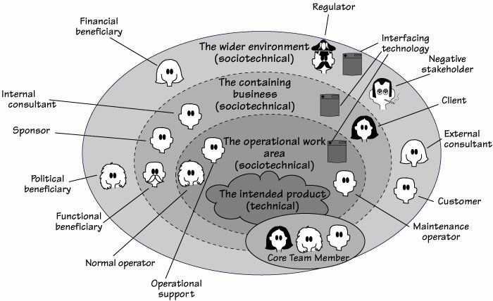
2. Identify Stakeholders [3]
A client pays for the development of the product.
Customers buy the product.
When we talk about users, we mean the people who will ultimately operate your product.

Slide 12
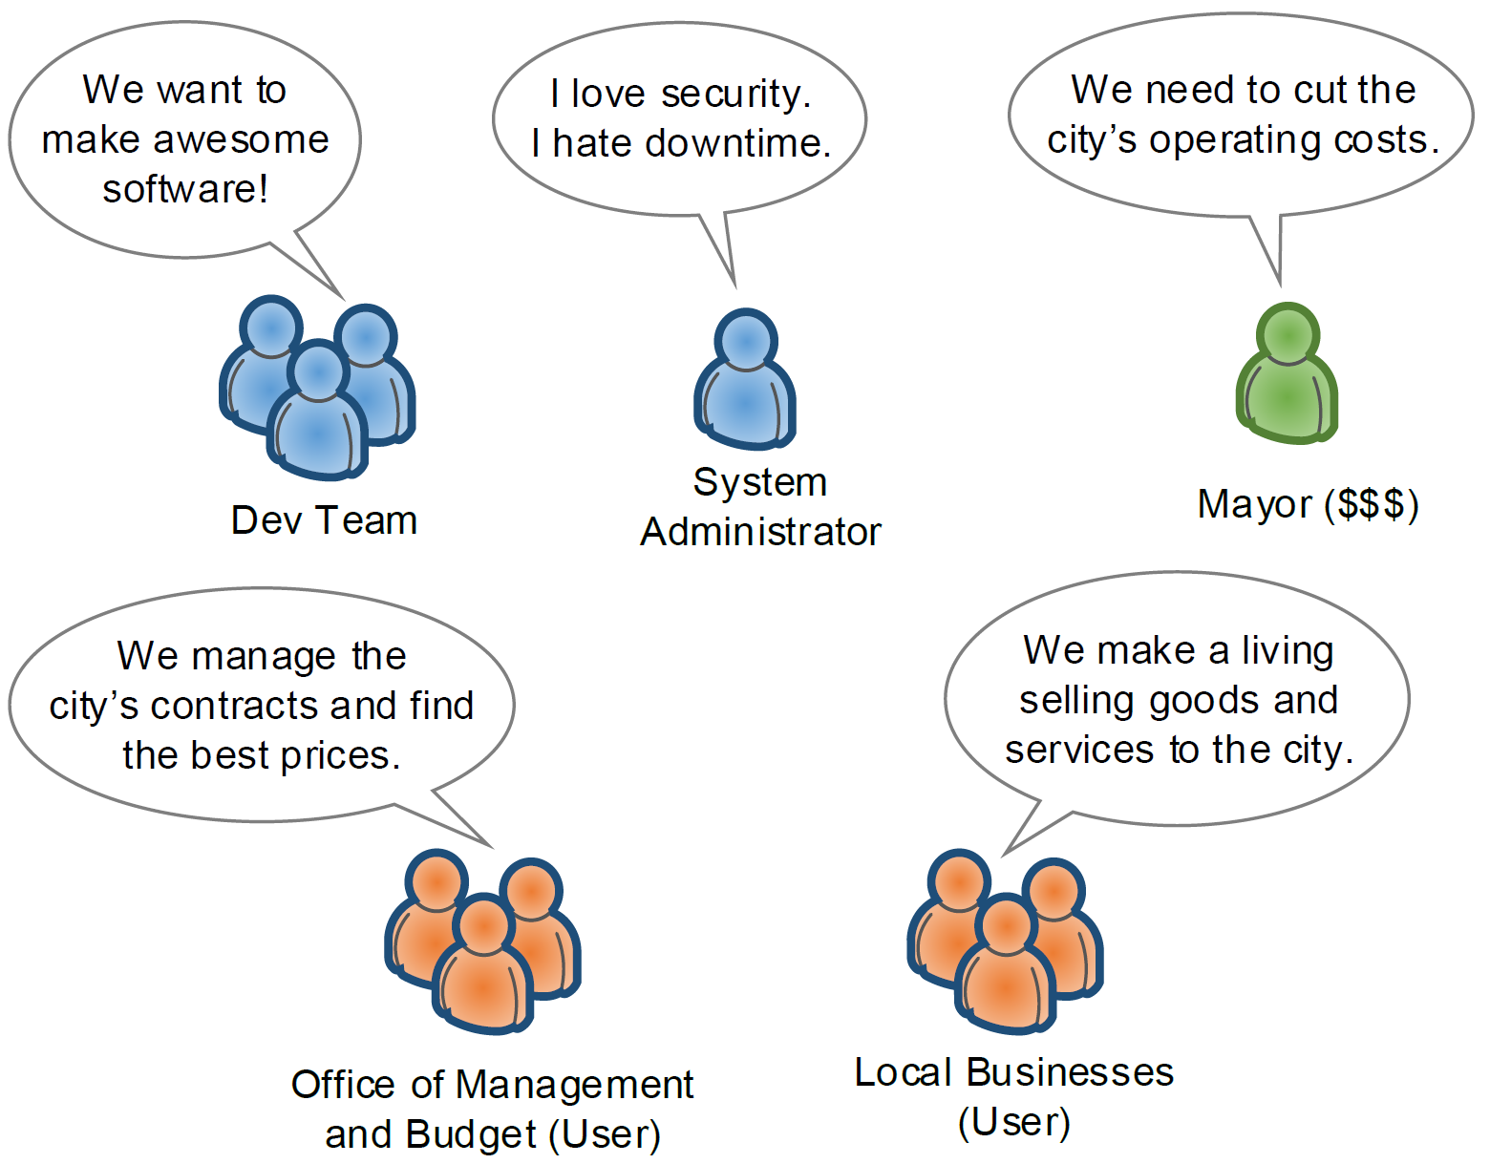
3. Identify Stakeholders [4]
Stakeholders usually, but not always, have a business interest in the software.
They might pay for the software or directly profit from it.

Slide 13
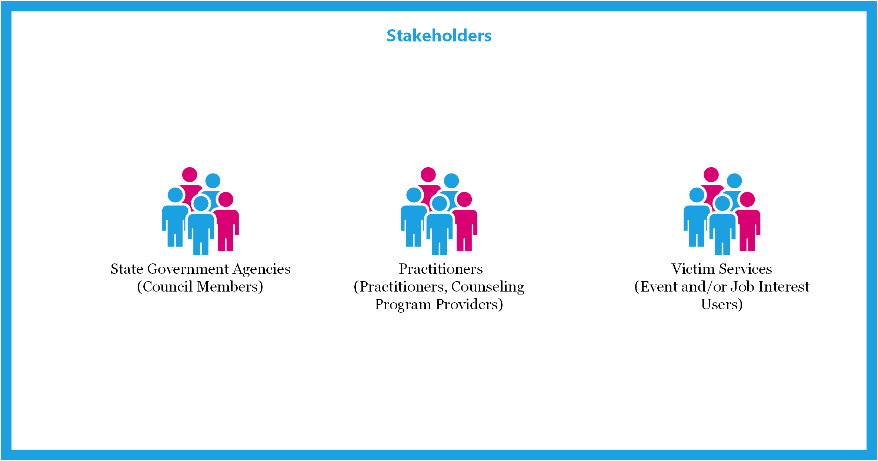
Example

Slide 14
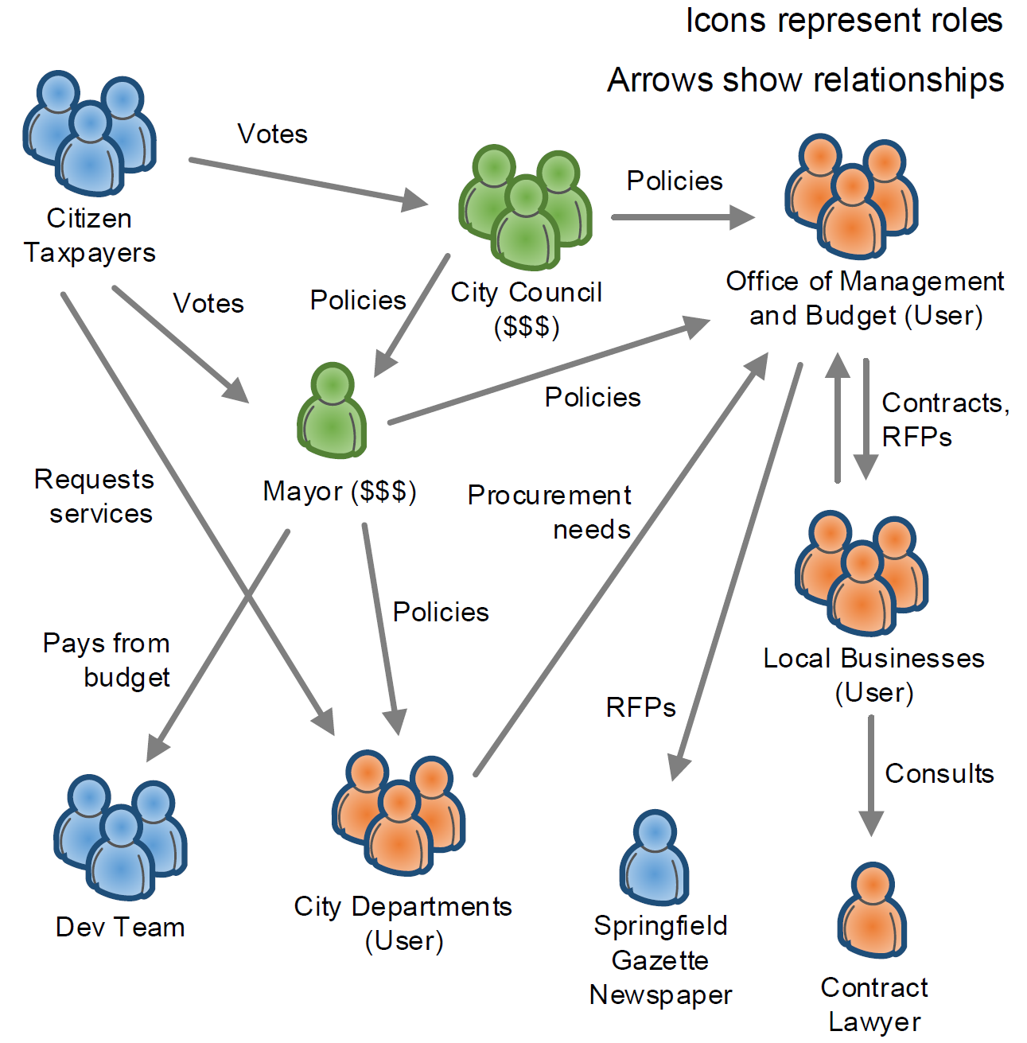
4. Create Stakeholder Map
A stakeholder map is a network diagram showing all the people involved with or affected by the proposed software system.
Stakeholder maps are ideal for visualizing relationships and interactions among people.
They also give you a snapshot of what motivates different stakeholders.

Slide 15

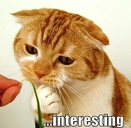
Domains of Interest [3]
"Roads freeze in winter, and icy conditions cause road accidents that kill people.
We need to be able to predict when ice will form on a road so we can schedule a de-icing truck to treat the road in time.
We expect a new system to provide more accurate predictions of icy conditions.
This will lead to more timely de-icing treatment than at present, which will reduce road accidents.
We also want to eliminate indiscriminate treatment of roads, which wastes de-icing compounds and causes environmental damage.“
Pay attention to the subjects.
Four domains: Roads, Weather, Scheduling, Trucking.

Slide 16
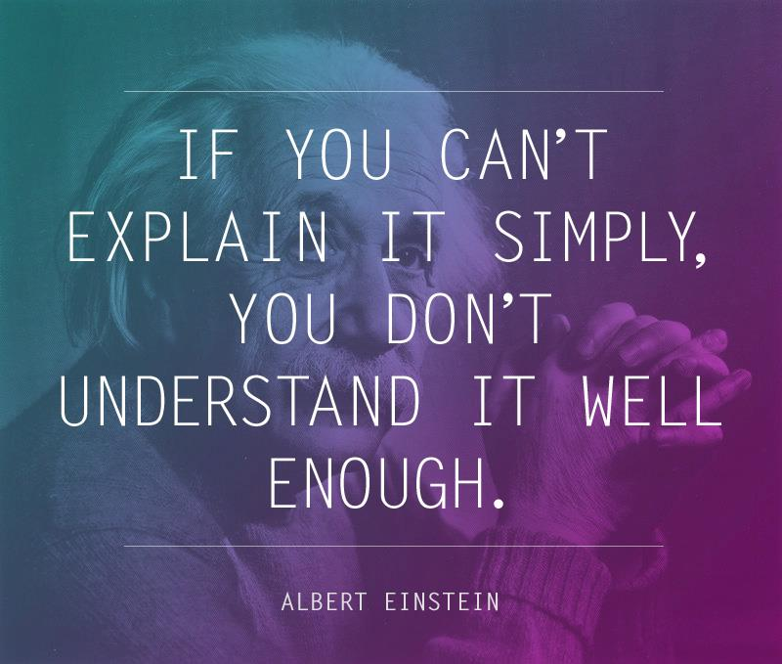
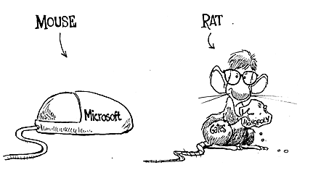
5. Define Terminologies (Terms)

Slide 17

6. Analyze Terminologies (Terms)
Build a background and context around the terminologies.
Expand terminologies into
Business roles,
Business workflows,
Business components,
Units/Departments
Business entities (objects), and
Business artifacts
AS MUCH AS POSSIBLE

Slide 19
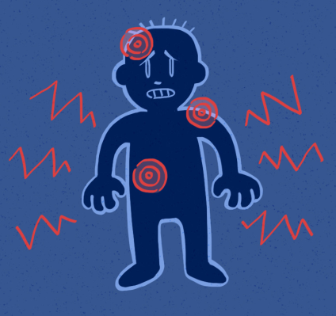
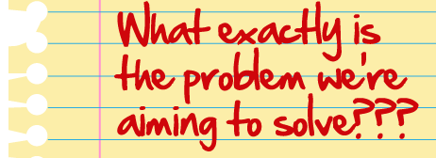
Problem Definition [2]
Formally, a problem can be defined as the differences between a goal state and the current state of a system.
Problem solving can be defined as a search process using actions to reduce or eliminate the differences.
PAIN, FEAR
HIGHT COST
TIME CONSUMPTION
BOREDOM
WE CANNOT…
IT’S DIFFICULT…
IT COSTS TOO MUCH…

Slide 21

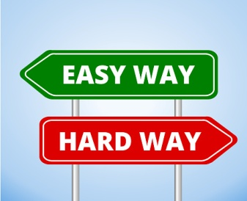
1. Document Operational Problems
Yearly budget for software development to support business operations
Bug fixes, security enhancements, task automation, digitalization, technology upgrade, compliance requirements.
Prepare RFP with concrete problems.
Done by organization employees (marketing managers, sales, support)

Slide 22

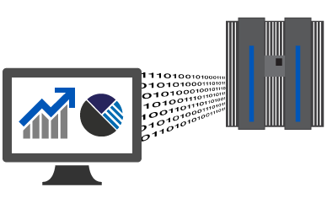
2. Handle RFP with Concrete Problems
Request for proposal
Meeting minutes
Existing systems
Existing source code and data
Similar systems

Slide 23

3. Prepare Response to RFP with Concrete Problems
Solution
Customer journey map
Customer user experiences in seeking and accessing services.
Cost

Slide 25

1. Handle RFP w/o Concrete Problems
Request for proposal
Meeting minutes
Existing systems
Existing source code and data
Research results that may be applied to existing systems.

Slide 26

2. Identify Operational Problems
Yearly budget for software development to support business operations
Bug fixes, security enhancements, task automation, digitalization, technology upgrade
Done by external entities.

Slide 27


3. Discover Problems Leading to New System Development
Building a new corporate information system (enterprise application) for a client
Start with a manual process,
a trivial existing solution,
outdated technologies,
compliance requirements, and
competitors' systems.
Client
Employees

Slide 28

4. Discover Problems Leading to Existing System Enhancements
Enhancing an existing corporate information system (enterprise application) for a client
Start with bugs, security issues,
performance issues,
compliance requirements,
integration requirements, and
competitors' systems.
Client
Supporters

Slide 29

5. Prepare Response to RFP w/o Concrete Problems
Discovered problems
Solution
Customer journey map
Customer user experiences in seeking and accessing services.
Cost

Slide 31

1. Handle Research RFP
Operational systems
Existing source code and data
Competitors' systems
Research papers
Meeting minutes

Slide 32
2. Identify Trending Technologies
Yearly budget for research related to software development
Trending technologies that competitors are using or are going to be using.
Done by external entities.

Slide 33
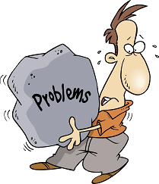


3. Discover Potential Enhancements
Conducting a research for a client
Start with existing systems,
competitors' systems, and
trending research results.
Client

Slide 34

4. Prepare Response to Research RFP
Discovered potential enhancements
Customer journey map
Customer user experiences in seeking and accessing services.
Cost

Slide 36

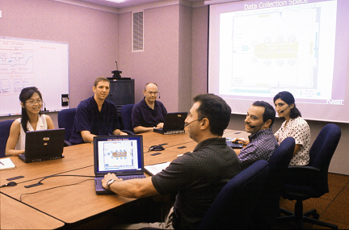
1. Identify Research or Product Opportunities
Savings
Practical problems based on knowledge, skills and experiences.
Stakeholders
Experiences

Slide 37
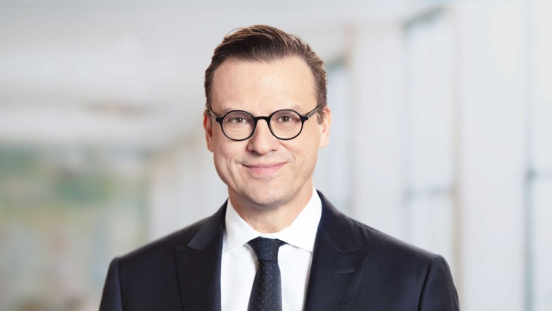

2. Discover Problems: The Easy Way
Problems might come from
corporate executives,
marketing managers
funding sponsors, or product visionaries

Slide 38
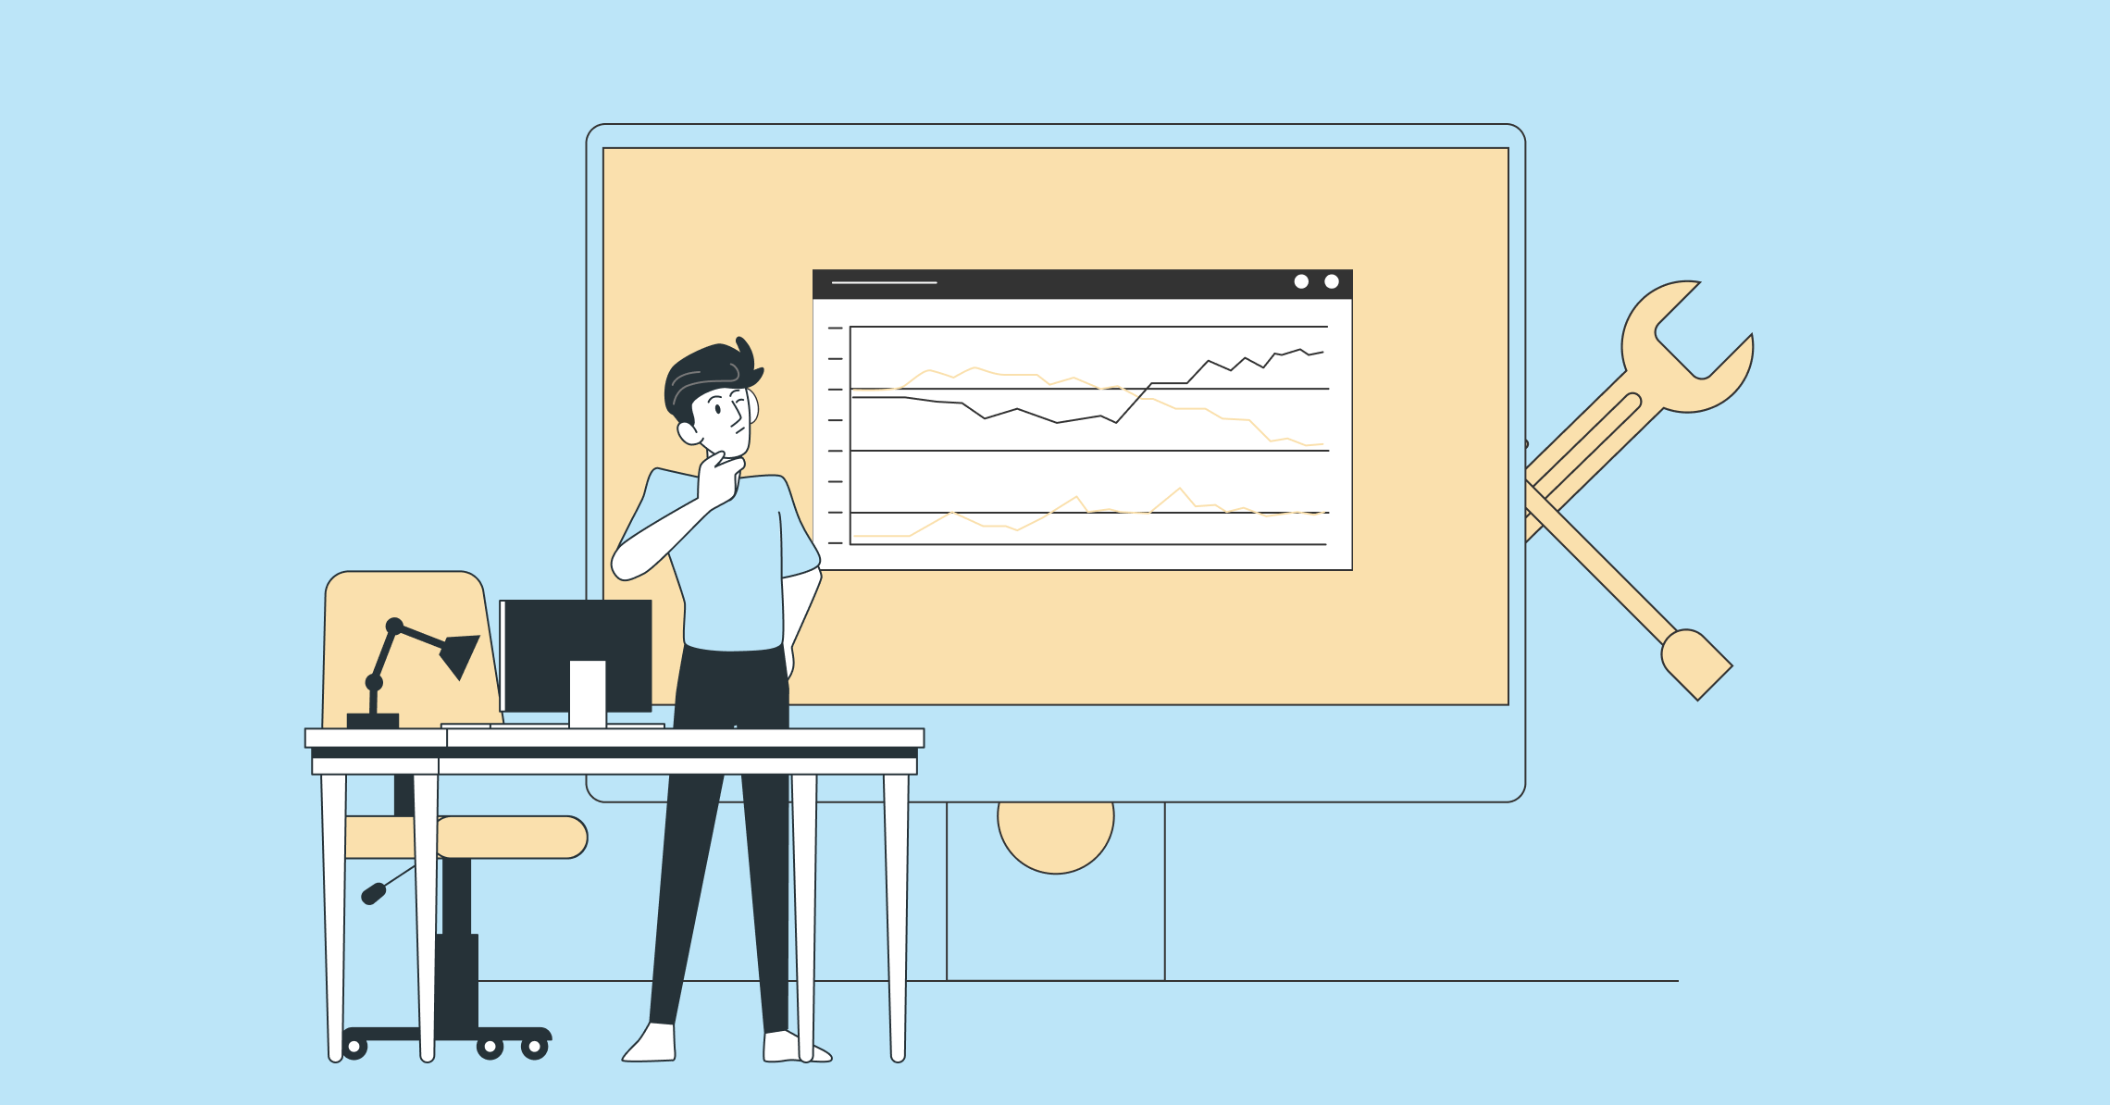
3. Discover Problems: The Hard Way
Real world scenarios (Practical problems)
Business workflows, business processes, domain models, business use cases (a bit of solution).
Competitors' products
Research papers.

Slide 39

4. Review Opportunities
Who is your sponsor? Name, phone number, and address?
Who is your client? Name, phone number, and address?
Who are your customers? Names, phone numbers, and addresses?
Salesforce's Business Model (SaaS), Dropbox's Business Model (SaaS)
Who are your users? Names, phone numbers, and addresses?
App Store, Google Play, AdSense, Spotify's Business Model
Amazon's Business Model (B2C), Uber's Business Model (C2C)
Who are your competitors?

Slide 40
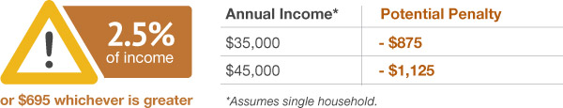
Example Opportunity
Did you know that having health insurance when you can afford is the law?
If you can afford health insurance, but choose not to get it for 2016, you may be required to pay a fee —sometimes called the “penalty,” “fine,” or “individual mandate” — when you file your 2016 federal income taxes.
Welcome to XYZ, the only place to apply for financial assistance to help reduce your costs.

Slide 41



Problem Relevance
The relevance of any design-science research effort is with respect to a constituent community.
For IS researchers, that constituent community is
the practitioners who plan, manage, design, implement, operate, and evaluate information systems and
those who plan, manage, design, implement, operate, and evaluate the technologies that enable their development and implementation.
To be relevant to this community, research must address
the problems faced and
the opportunities afforded by the interaction of people, organizations, and information technology.

Slide 43


Goals
Goals: What do you want to achieve?
[Oxford Dictionary] Something that you hope to achieve.
The project goal is the highest-level requirement.
All of the detailed requirements must make a positive contribution toward reaching that goal.

Slide 44

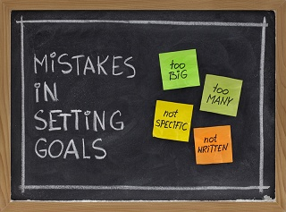
Goal Settings
Purpose: To accurately forecast road freezing times and schedule de-icing treatment.
Advantage: To reduce road accidents by eliminating icy road conditions.
(Optional) Measurement: Accidents attributed to ice shall be no more than 15 percent of the total number of accidents during winter.
Vague purpose: To improve the way we do business.

Slide 45
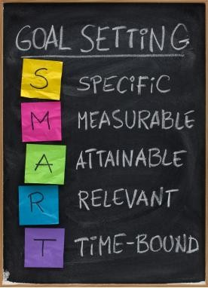
SMART Goals (aka Objectives)
A SMART goal is a well-defined target that gives you clarity, direction, motivation, and focus.
What? Why? Who? Where? Which?
How much? How many? How will I know when it is accomplished?
Which steps? How can the goal be accomplished?
Does this seem worthwhile?
When? What can I do 6 months from now? What can I do 6 weeks from now? What can I do today?

Slide 46

1. Identify Business Goals
For a client's corporate information system, describe
the business problem that is being solved or
the process being improved, as well as the environment in which the system will be used.
For a commercial product, describe
the business opportunity that exists and
the market in which the product will be competing.
This section could
include a comparative evaluation of existing products, indicating why the proposed product is attractive and the advantages it provides.
describe the problems that cannot currently be solved without the envisioned solution.

Slide 47

Common Business Goals [3]
Reduce costs and time.
Improve customer service.
Improve communication.
Improve decision making.
Create or strengthen relationships with suppliers, customers, or partners.
Improve processes.
Improve reporting capabilities.
Support new legal requirements.
Bring more pleasure.
Create a new product or service. Is this product valuable?
Be measurable

Slide 48

Customer Discovery for a Product
Who? – Friends, former colleagues, investors, employees, students, existing customers.
Where? – Universities, hospitals, streets, media, conferences, trade shows.
What? – Personal information, pains/needs/happiness, reasons, comments.
How? – Survey, demo, trial version.

Slide 49
Common Business Goals
Who wants it | What they want
Individuals | Increase wealth, power, reputation, personal enjoyment, or knowledge
Organizations | Increase revenue, maximize profits, grow the business, become a market leader, improve stability, enter a new market, beat a competitor
Employees | Interesting and meaningful work, increase knowledge, help users, become recognized as an expert
Development Team | Improve specific quality attributes, reduce costs, add new features, implement a standard, improve time-to-market
Nations, Governments | Security, civic welfare, social responsibility, legal compliance

Slide 51
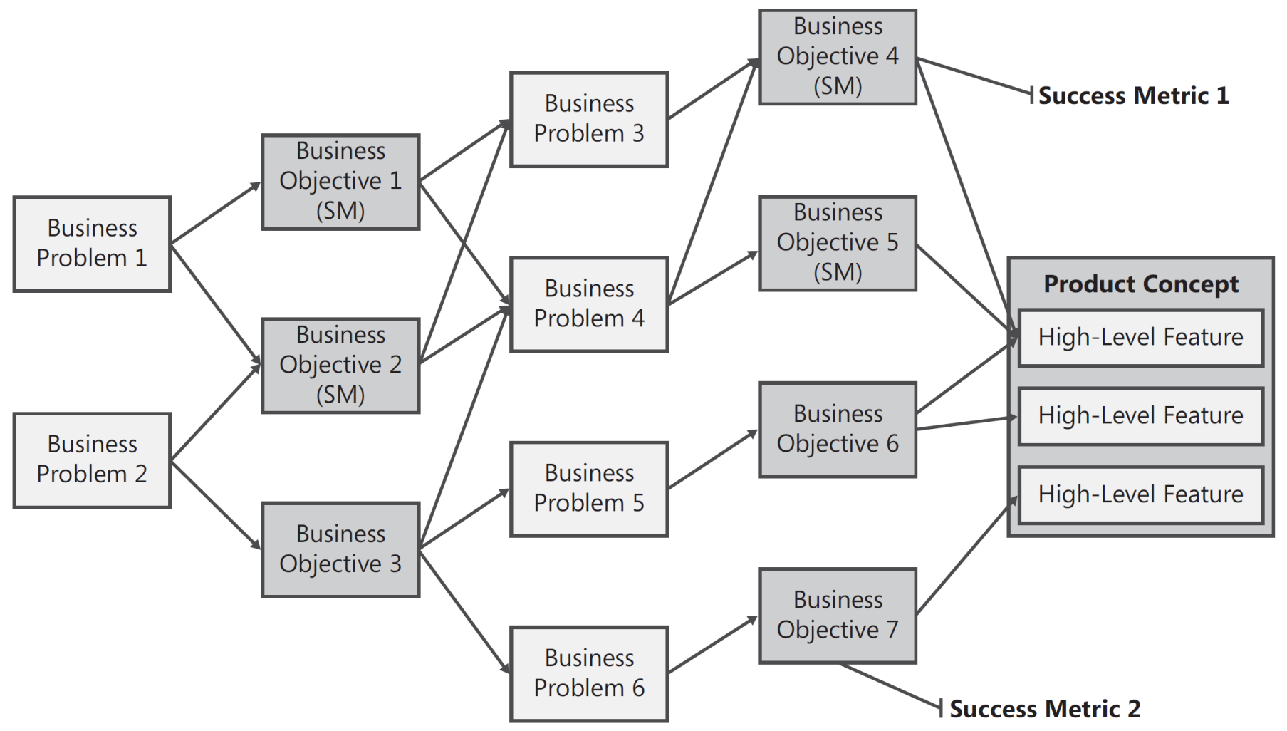
Business Objectives Model [5]

Slide 52
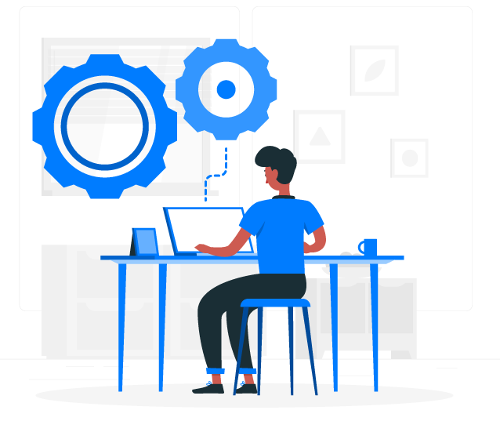

2. Identify High-Level Features
STAKEHOLDERS' GOALS
HIGH-LEVEL
FEATURES

Slide 54

Deliverables
Item | Assignee | Approved By | Due Date
Requirement specification
Test specification, test data and test results
Design specification
Administrative guide, user guide
Acceptance testing, production environment, data migration utility
Source code
Development plan (schedule/preliminary release plan)

Slide 55
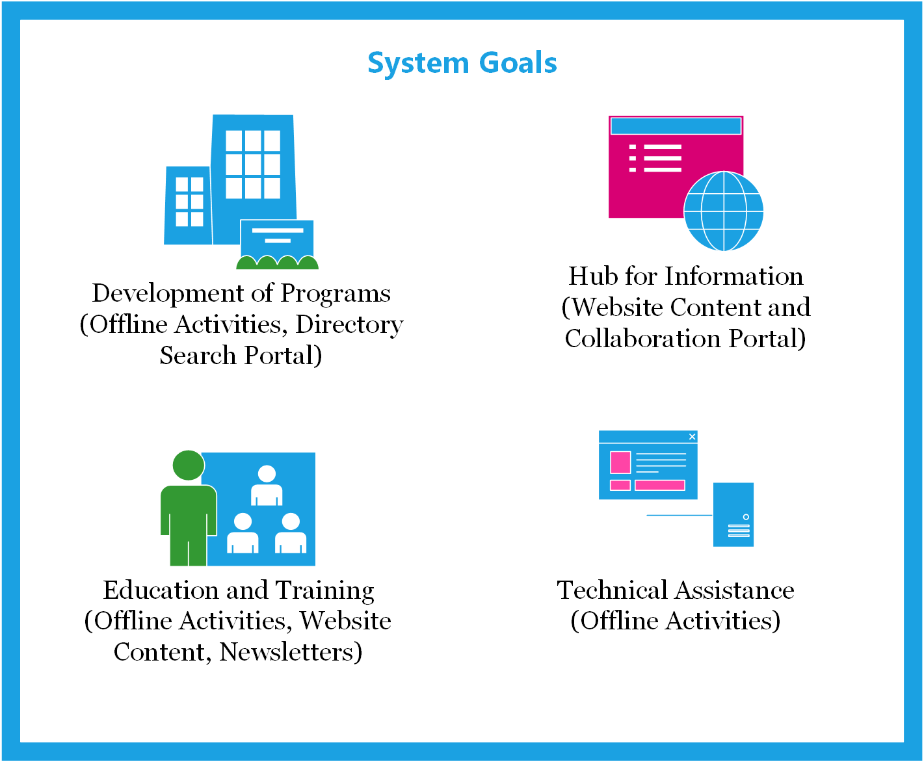
Example Software and Services

Slide 56


3. Define Expected Products
Build a procurement list of products (artifacts) and services.
Also include a business level feature list.

Slide 58

4. Set the Scope [3]
The scope you are interested in is the scope of the work for which the product is to be used.
Work here means the business activity for which the user needs the product.
Setting the scope of the work means you determine what work you are about to study, what other pieces of work surround it, and what flows of information make up the connections.
When you set the scope, you are deciding how much of the work you will study and what you will not study. But how? – See context diagram & ecosystem map!

Slide 59
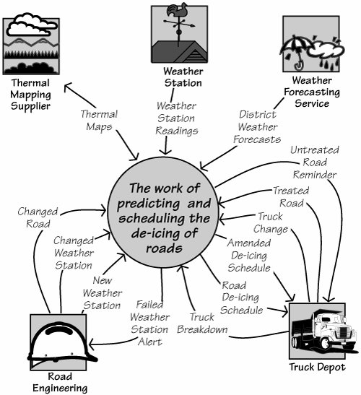
Context Diagram
The work context diagram identifies the scope of the work that we intend to study.
It shows the work as a single, as-yet uninvestigated process, surrounded by the adjacent systems.
The work context shows where the responsibilities of the work and the responsibilities of the adjacent systems start and end.
First understand the work, then decide which product best supports that work.

Slide 60
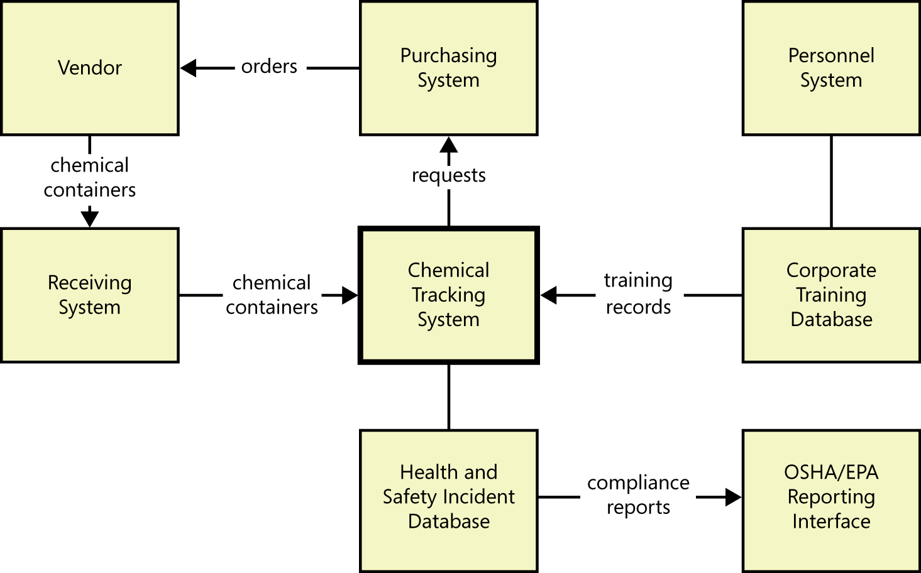
Ecosystem Map [1]

Slide 62
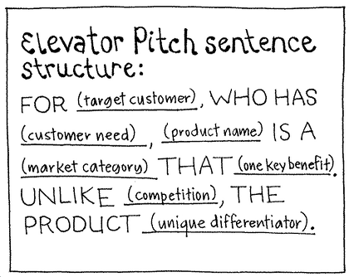
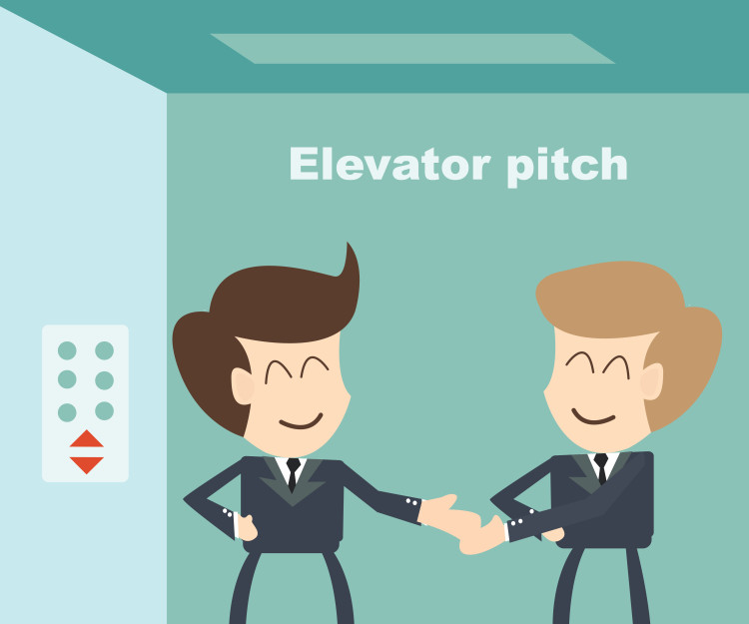
5. Create an Evaluator Pitch

Slide 63
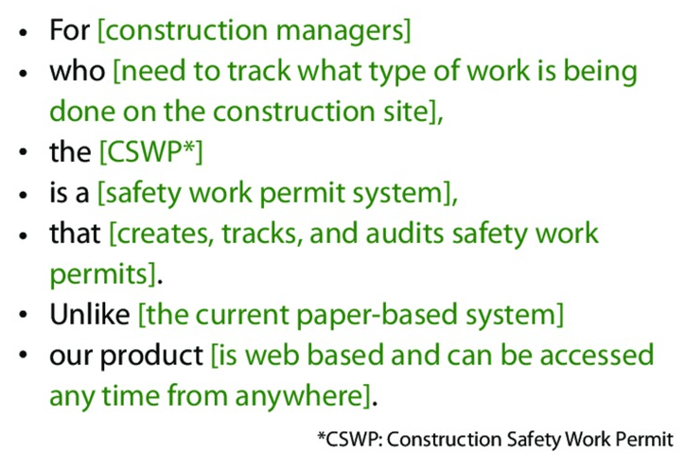
Example

Slide 65


6. Create Project Proposal
The market/target audience (the sponsors, the customers, the users, the stakeholders).
The budget, the timing.
The pain points/problems/needs.
The solution (The core business use case).
The competitors/weakness/differentiators.
The risks/strengths/opportunities/grand vision.
The business goals, the reasons to solve the problems (the predicted benefits, revenue and incomes).
For a commercial product: The customer discovery report.
The high-level features, the expected artifacts.
The context diagram, the elevator pitch.

Slide 67

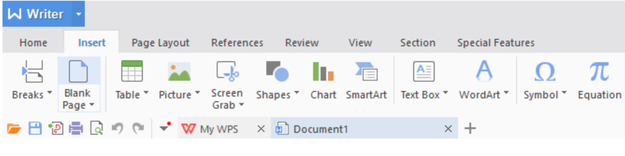
Tools
http://office.microsoft.com/en-us/
https://www.wps.com/wps-office-personal

Slide 68

Thank You & See You Again

